Slide 1
T24 CUSTOMER
MARCH 2014

Slide 2
Objectives
In this session, you will learn about
Overview and Features of customer application in T24
Opening of customer records for individual, corporate and bank customers
Amendment of customer records
Customer related enquiries and search options

Slide 3
Overview of T24 Customer
Customer application is central or core to T24 system as all activities are customer centric in nature .
All Management information and services revolves around customer record
It contains all the basic information about any entity that the bank is dealing with
Notes:
Customer application is central to organisation of information, services and pofit & loss.

Slide 4
Overview of T24 Customer
Information contained in the customer record is only descriptive in nature and not financial
Customer record once created will be used by all other applications in T24
In T24, Customer records are opened and maintained for
Clients: Private, Corporate
Agents: Other Banks, Brokers
Counterparties: Other Banks, Retail and Corporate
Notes:
Customer application is central to organisation of information, services and pofit & loss.

Slide 5
Features of Customer Application Account and contract based application
Customer
Current Account
Loans and Deposits
Savings Account
Foreign Exchange
Nostro Account
Money Market
Securities

Slide 6
CUSTOMER – STATIC TABLES
INDUSTRY
CUSTOMER.STATUS
SECTOR
CUSTOMER
COUNTRY
DEPT.ACCT.OFFICER
TARGET
Notes:
INDUSTRY – for occupation details
SECTOR – Classification for preferential charges, reports etc
COUNTRY - Nationality and Residence Details
TARGET - marketing and cross selling
DEPT. ACC.OFFICER – only person listed in this file be the AO for the customer
CUSTOMER.STATUS -

Slide 7
Features of Customer Application
Customer record is created prior to any activity related to that customer in T24
Customer record is created as soon as essential details are avialable, which is independent of account opening or any business transaction. Additional details can be added any time
Customer Record is created only once and using the Customer ID all the reports and enquiries are generated
It is not possible to reverse an authorized Customer Record

Slide 8
Features of Customer Application
Different types of Customers can be created in T24
Individual
Corporate Clients
Residential status to differentiate resident & non resident
Agents
Counterparties
Linking of customers with unique relationship code can be organized to distinguish related customer & group customers

Slide 9
Features of Customer Application
ID can be up to 10 digits which can be a manually created ID or an auto generated ID
CUSTOMER.DEFAULT Field to default values such as Industry,Target, Nationality, Residence, Account Officer, Customer status based on the value given in “Sector” Field

Slide 10
Customer Record – Mandatory field details
CUSTOMER MNEMONIC
An alternative means to refer a customer
ID is unique across T24
SHORT.NAME
A briefer version of the name of the Customer, which will be used for on-line enrichments, in any field where a Customer ID or Mnemonic has been input.

Slide 11
Customer Record – Mandatory field details
ACCOUNT OFFICER
Identifies the Officer responsible for the Customer
Allows generation of MIS information at the Account Officer level
SECTOR
Identifies the Sector Code relating to the Customer
TARGET
How the Customer is considered by the Bank with respect to the Bank’s marketing strategy

Slide 12
Customer Record – Mandatory field details
INDUSTRY
Identifies the industry in which the Customer belongs
LANGUAGE
Identifies the Customer’s language to be used for correspondence
ADDRESS FIELD
For correspondence and to be used as the default print address. System maintains details in DE.ADDRESS and possible to make non mandatory using CUSTOMER.DEFAULT

Slide 13
Customer Record – Optional field details
IDENTIFICATION DOCUMENTS
Legal Identification documents and details can be specified
CONTACT DETAILS
Introducer name, date of contact
RELATION CUSTOMER AND RELATION CODE
Identifies the Customer Code or the Mnemonic of the related customer
Multiple relations can be set up
Relation code identifies the inter-relationship between Customer records and enables a link to be formed for the purpose of evaluating the overall customer position

Slide 14
Customer Record – Optional field details
LIABILITY CUSTOMER
Indicates the customer consolidation number for credit grouping purposes Limit sharing between Group companies
After authorisation, becomes a no-change field and can be changed only through LIMIT.CHANGE Field
CUSTOMER RELATIONSHIP MANAGEMENT
Cross selling
Financial, Residential and further details can be specified

Slide 15
Customer Record – Optional field details- KYC
Exclusive customer ID helps bank to fulfill KYC norms.These information can be recorded in Fields
LAST.KYC.REVIEW.DATE
AUTO.NEXT.KYC.REVIEW.DATE,
MANUAL.NEXT.KYC.REVIEW.DATE
KYC relationship and KYC completion details can also be indicated
Rating of customers can be synchronized with each customer with multi agencies in Customer. Rating field

Slide 16
Customer - Workshop 1
Create an Individual customer record
Choose Sector as 1001 (Individual). Retain the defaulted values of Target and Customer Status and Account officer
Change defaulted value in the following fields
Account officer as 3
Nationality and Residence as US
Choose INDUSTRY AS 1000
Give values in ADDRESS, LEGAL DOC, FINANCIAL, RESIDENTIAL AND FURTHUR DETAILS tab
Create KYC and link to the customer record
Commit the data. Get the record authorized.

Slide 17
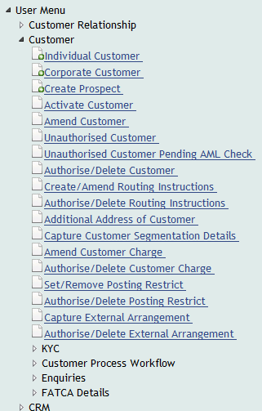
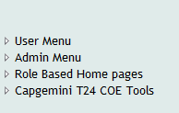
Customer - Workshop Solution1

Slide 18
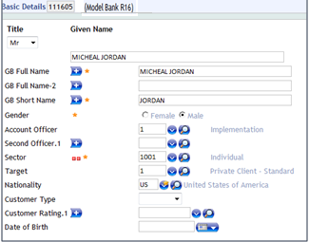
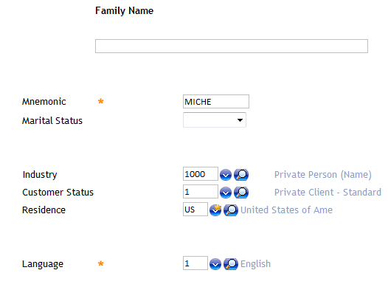
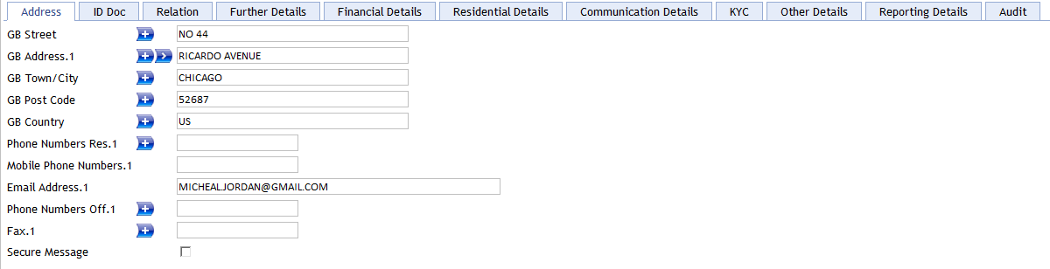
Workshop 1 - Solution

Slide 19
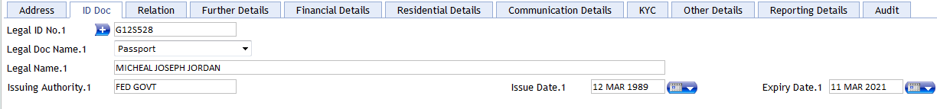
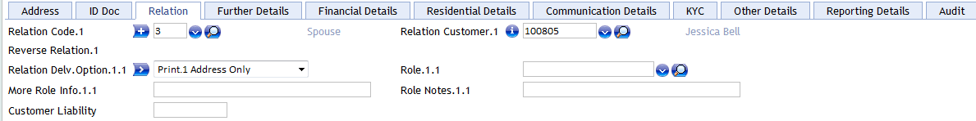
Workshop 1 - Solution

Slide 20
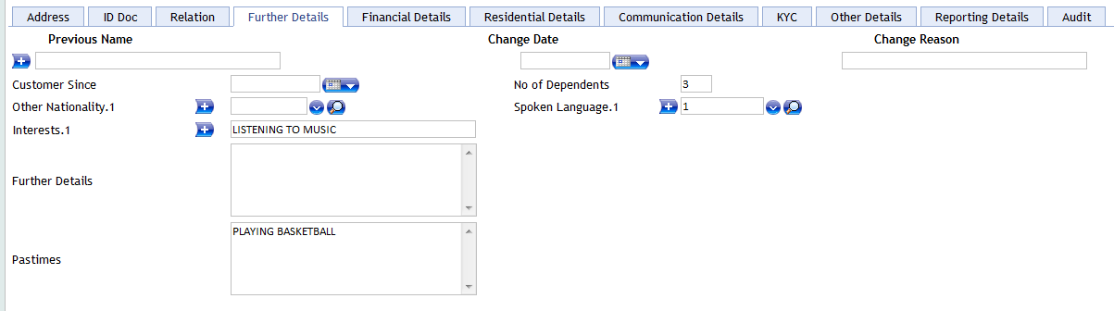
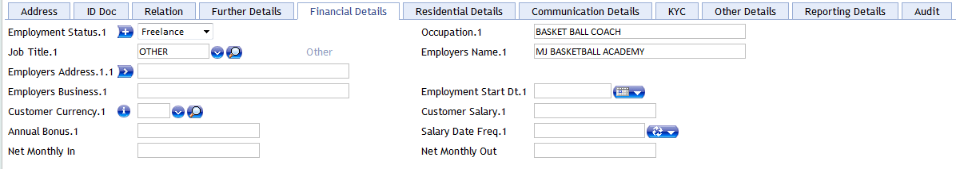
Workshop 1 - Solution

Slide 21
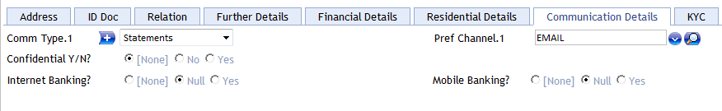
Workshop 1 - Solution

Slide 22

Create KYC – workshop 1

Slide 23
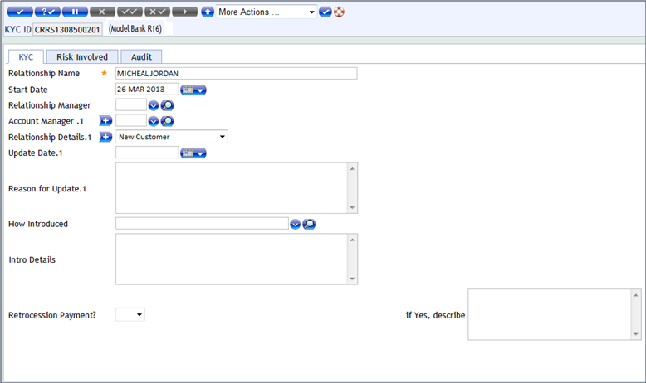
CREATE KYC- Workshop 1 - Solution

Slide 24
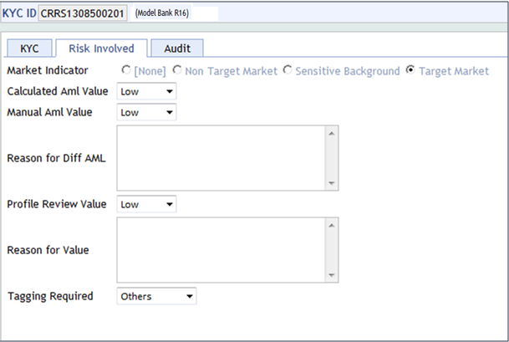
CREATE KYC - Workshop 1 - Solution

Slide 25
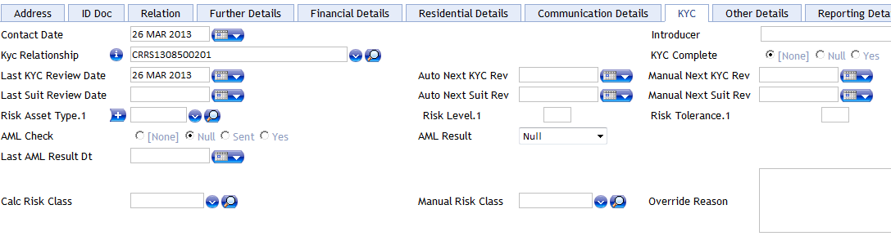
Linkage of KYC with the Customer Record

Slide 26
WORKSHOP 2
Make the following amendments to your Customer record through
Customer Menu – Amend Customer Details Sub menu
Choose the Introduction Details tab and indicate the introducer as
John Abraham
Choose the Relation Details tab and include an additional Relation Customer
Commit and authorize the data.

Slide 27
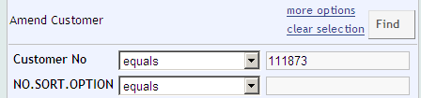
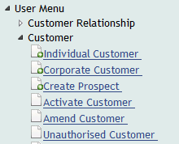

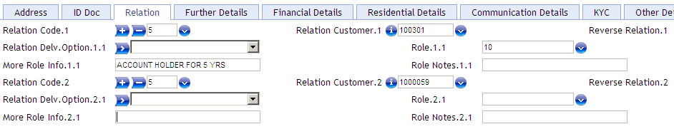
Workshop 2 - Solution

Slide 28
Posting Restrictions
POSTING.RESTRICT table identifies whether any restrictions have been imposed for posting entries for a particular customer.
Posting restrictions, if set at Customer level controls all accounts of the Customer
Posting restrictions are such as “Post no debits”, “Post no credits”, “Refer all debits to supervisor” etc

Slide 29
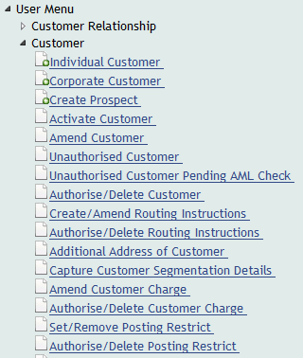

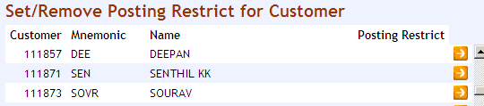
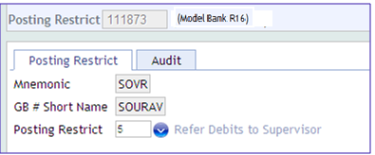
Set/ remove Posting Restrictions – Workshop 3

Slide 30
Customer Charge
Periodic charges to be levied against the customer based on the charge group for applications such as Funds transfer, Securities, Letters of credit etc
A record for each customer will be automatically created whenever a new "customer" record is authorized
Charges created can also be amended

Slide 31
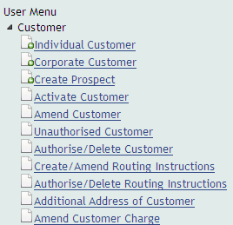


Amendment of Customer Charge – Workshop 4

Slide 32
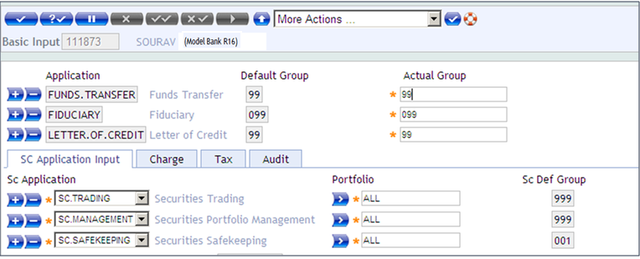
Amendment of Customer Charge – Workshop 4

Slide 33
Additional Address
When a Customer record is opened, System maintains the address in DE.ADDRESS as PRINT.1 address of the Customer
This is the address used for communication
Sub menu Additional Address of Customer is available for inputting additional PRINT, SWIFT and TELEX addresses.
Record Id can be input as C-CUSTOMER ID.DELIVERY CARRIER.SERIAL NO

Slide 34
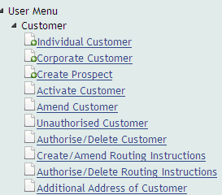

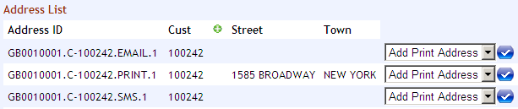
Additional Address Input – Workshop -5

Slide 35
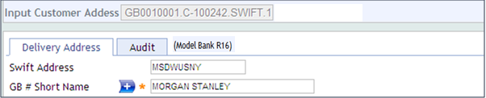
Additional Address Input – Workshop 5

Slide 36
Prospect Customer
Bank can create a customer record for prospective customer
Bank may or may not allow business activity based on the setup in company table in PROSPECT.ALLOWED Field
Retention of Prospect customer record to be specified in CUST.Retention Field in Company Table. Input D or M
Prospect Record can be reversed
CUSTOMER.TYPE to be set as active for a prospect record

Slide 37
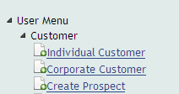
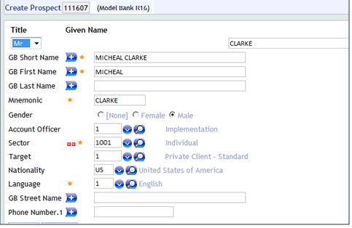
Creating prospect customer – Workshop 6

Slide 38
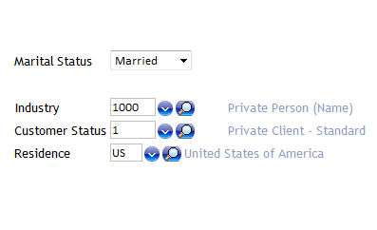
Creating prospect customer – Workshop 6

Slide 39
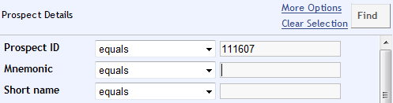
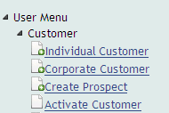
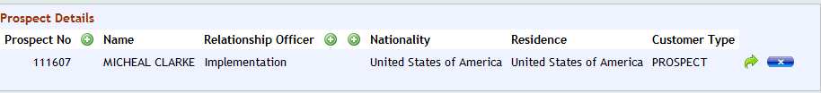
Activating prospect customer – Workshop 7

Slide 40
Perquisites for creation of a bank record
To be predefined as Bank in ACCOUNT.CLASS table
ID of Account. class table will be “Bank”
Only if it is defined as a Bank, it will be treated as a bank customer in other applications such as Account, FT, etc
Sector to be chosen as “Bank” WHILE CREATING THE RECORD

Slide 41
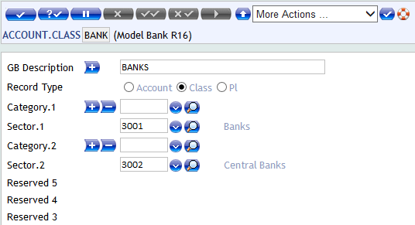
ACCOUNT.CLASS RECORD
ID will be “Bank”
Sector codes are to be defined here.

Slide 42
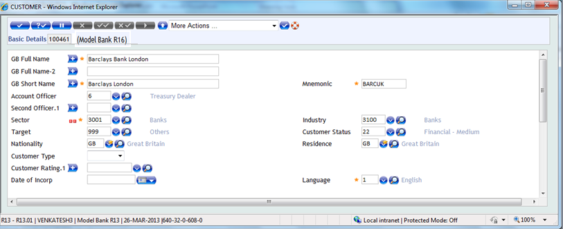
Customer record – Bank
Sector code to be chosen as 3001 for banks

Slide 43
Agency Record for Bank customers
Agency record can be created only after creating a customer record for a “Bank”
Used for Standard settlement Instructions while dealing with the concerned bank
Useful for routing settlement instructions

Slide 44
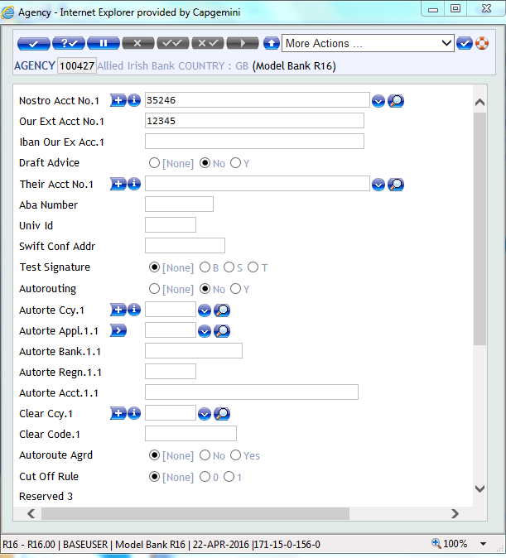
Agency Record
An agency record created for allied Irish bank, the prerequisite is the customer record for allied Irish bank

Slide 45
Enquiries
By clicking on Enquiry sub menu, we can access the following enquiries
Customer Search Full
Customer wise details of Name, Nationality, Residence, Sector,
Account officer and Industry are available. Can drill down to view
Customer liability and position summary from here
Customer Relation
Customer wise relationship details. Can drill down to view reverse relationship details also

Slide 46
Enquiries
Customer Accounts
Customer wise account details displaying list of Account Numbers, Account Mnemonic, Account type, Currency, Working balance, Ledger balance and Cleared balance. Can drill down to view accounting entries for the day, Entries since last statement as well as Forward movements

Slide 47
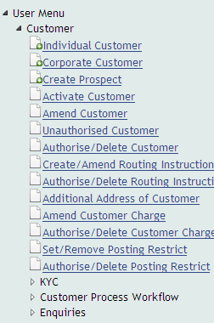

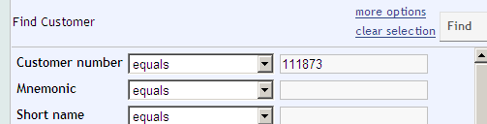
Enquiries

Slide 48

Enquiries

Slide 49
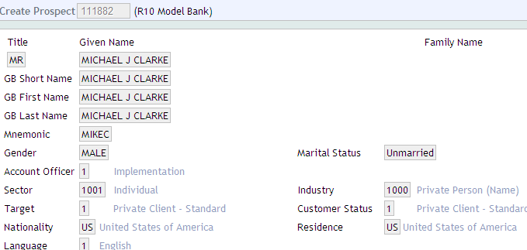
Enquiries

Slide 50
Enquiries

Slide 51
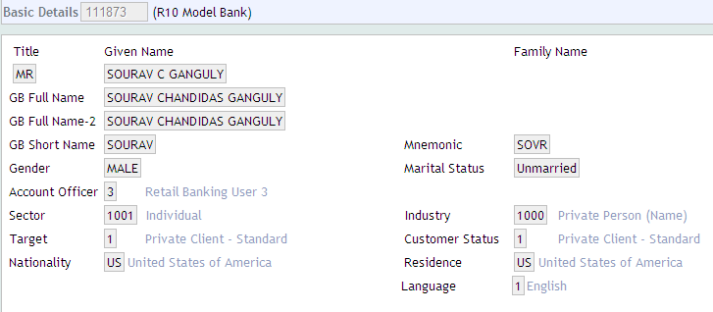
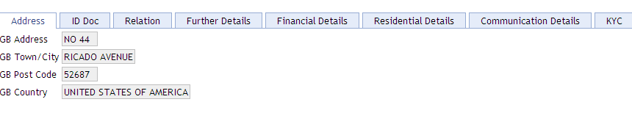
Enquiries

Slide 52
Enquiries

Slide 53
Self Practice -Creation of Corporate Customer
Open a Corporate Customer record for ABC International by
using Customer Menu – Open Corporate Customer sub menu
Use Sector code 2001, Target code 7, Industry code 1800 – Health care
Account officer - 3
Nationality and Residence as US
Customer Status code 21 – Financial – small
Language code 1 – English
Input suitable address
Commit and authorize the Record.

Slide 54
Self Practice -Creation of Bank Customer
Open a Corporate Customer record for ABN bank by
using Customer Menu – Open Corporate Customer sub menu
Use Sector code 3001, Target code 30, Industry code 3100 – Banks
Accounts officer - 27
Nationality and Residence as US
Customer Status code 21 – Financial – Medium
Language code 1 – English
Input suitable address
Commit and authorize the record.

Slide 55
Summary
At the end of this session, you have learnt about
Overview and Features of customer application in T24
Opening of customer records for individual, corporate and bank customers
Amendment of customer records
Customer related enquiries and search options

Slide 56
Thank you

